Slide 1





HEALTH WEALTH CAREER
#DECODETALENT
GET MOST OUT OF YOUR CAMPUS HIRING PROGRAMS
Assess Candidate Fit with Technology
September 2019

Slide 2


?
FOOD FOR THOUGHT
74%
Organizations say Talent Acquisition is a Challenge in 2019
67%
1 in 4
Organizations believe
Campus Hiring is the best channel to source talent
Organizations attend
25+ Campuses each season

Slide 3
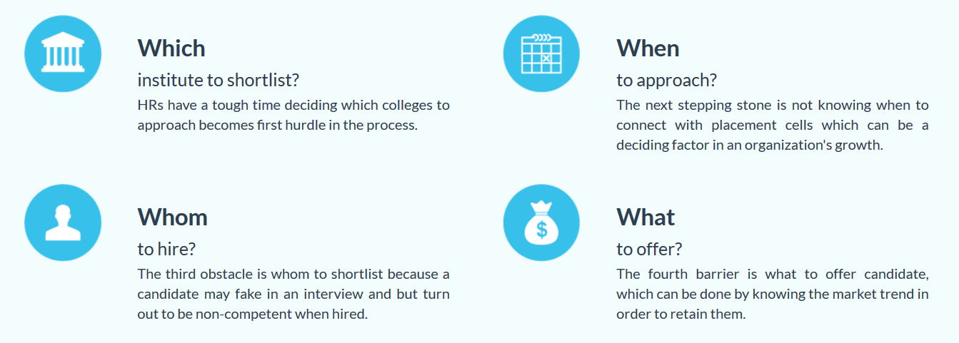
THE BIG CAMPUS HIRING DILEMMA: 4Ws
Are you spending too much for Hiring from Campuses?

Slide 4
CAMPUS HIRING BEST PRACTICES
Build Campus Intelligence
Invest in your Brand
Assess for Skills & Fitment

Slide 5
CAMPUS HIRING BEST PRACTICES
Build Campus Intelligence
Invest in your Brand
Assess for Skills & Fitment

Slide 6
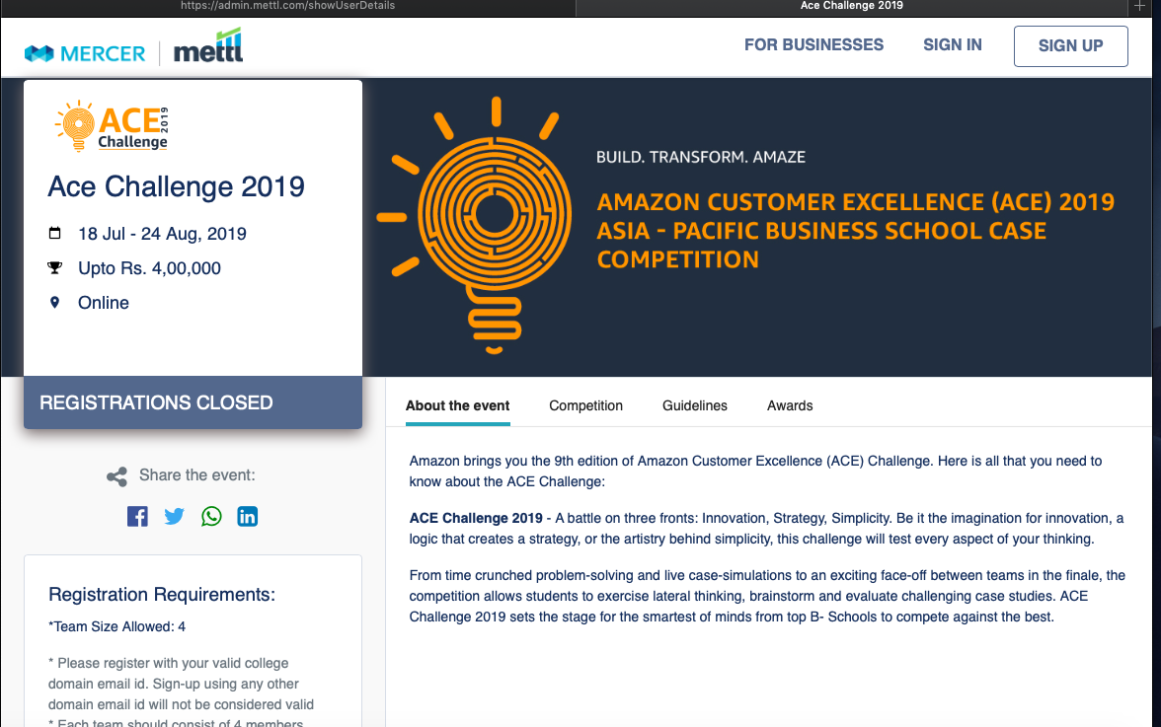
CAMPUS HIRING BEST PRACTICES
Build Campus Intelligence
Invest in your Brand
Assess for Skills & Fitment

Slide 7

CAMPUS HIRING BEST PRACTICES
Build Campus Intelligence
Invest in your Brand
Assess for Skills & Fitment
ASSESSMENTS
PERSONALITY TOOLS
SKILL TESTING
(IT/NON-IT)
COGNITIVE/ APTITUDE
+
+
Helps predict cultural fitment & personality relevant in workplace.
Simulates work skills & requires candidates to respond to them.
Measure reasoning and logical thinking skills
VIDEO INTERVIEWS
CODING INTERVIEWS
PRE-RECORDED INTERVIEWS
+
Measure IT skills collaborative coding interviews
Measure basic communication skills remotely

Slide 8
Q & A

