Slide 1
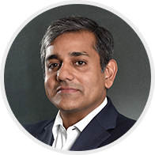
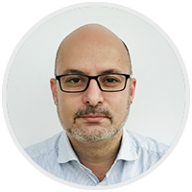
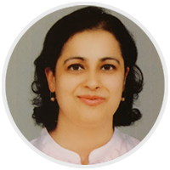
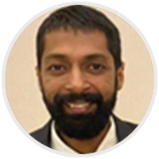
Live demo: How to conduct your examinations online
29th April 2020
Siddhartha Gupta
Chief executive officer,
Mercer | Mettl
Sharad Sharma
Chief product officer,
Mercer | Mettl
Nachiketa Chandra
Director- Product Development
Mercer | Mettl
Kaustubh Bansal
Associate Director- AI & Proctoring
Mercer | Mettl
Copyright 2019 Mercer LLC. All rights reserved.

Slide 2
Changing scenario of examinations..
Traditional examination
Online examination
Faculty
Student
Faculty
Student
Take Exam
Anytime, Anywhere
Create
Question Paper
Reach Center
@ Fixed Date/Time
Configure
Online Exam
Physical
Invigilation
Take Pen & Paper
Exam
Online Invigilation
& Proctoring
Real-time
Results
Manual
Grading
Results
After Months
Automatic
Grading

Slide 3
Key challenges while shifting examinations online
1
Question type/format supported and assessment creation
2
Accessibility and connectivity in even the remote areas
3
Maintaining the credibility and academic integrity
4
Generating results with
insightful reports

Slide 4
All exams can be taken online
In-course
quizzes
Mid-term
exams
Entrance
exams
Semester/
Final exams
Controller of examination
Capability to take all question types online
Multiple
Choices questions
Fill in
The blanks
Short
Answers
Long
answers
Formula/
Diagram

Slide 5
DEMO: steps to take your examinations online
Creation
Delivery
After the Test
Step 1
Step 2
Step 3
Step 4
Step 5
Setup
Exam
Invite
Test-Takers
Authorize
Proctor Tests
Real-Time Results
Group-Level Analytics

Slide 6
Question and Answers
Please use the Q&A window to post the questions.

Slide 7
Want to revolutionize your examination and learning space?
Get in touch with an expert
contact@mettl.com
www.mettl.com

